Slide 1

MONTGOMERY COUNTY’S SALARY DISTRIBUTION
FINAL REPORT PRESENTATION
-----------------------------------
DATA 205: DATA SCIENCE CAPSTONE
BY: HONORE NGUESSAN WEDNESDAY, MAY 13 2020

Slide 2
OVERVIEW OF THE DATASETS
Data Source: from dataMontgomery.
Website: https://data.montgomerycountymd.gov/
Datasets Content:
Employee salary 2018: 10,071 Observations with 12 variables.
Employee salary 2017: 9,398 Observations with 12 variables.
Employee salary 2016: 9,228 Observations with 12 variables.
Variables Of Interest: Gender, Assignment Category, Current Annual salary, Gross Pay Received, and Overtime Pay.
Research Goals:
Analyze the trend and variability of salary between 2016 and 2018.
Evaluate the relationship between the different component of salary.

Slide 3
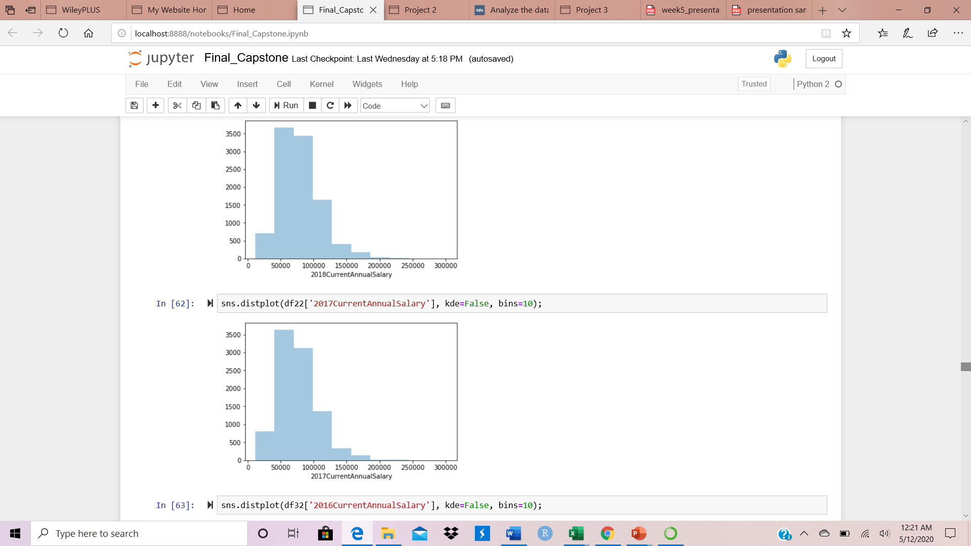
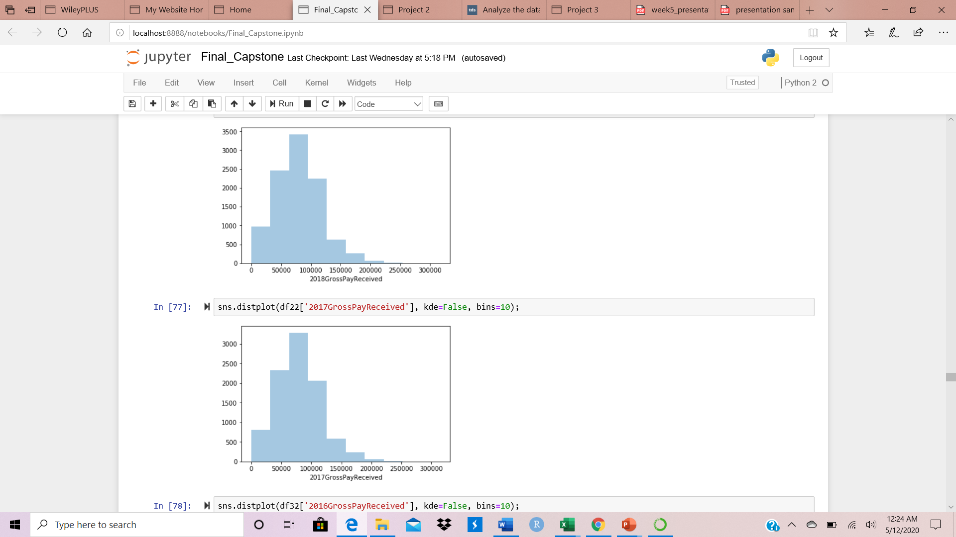
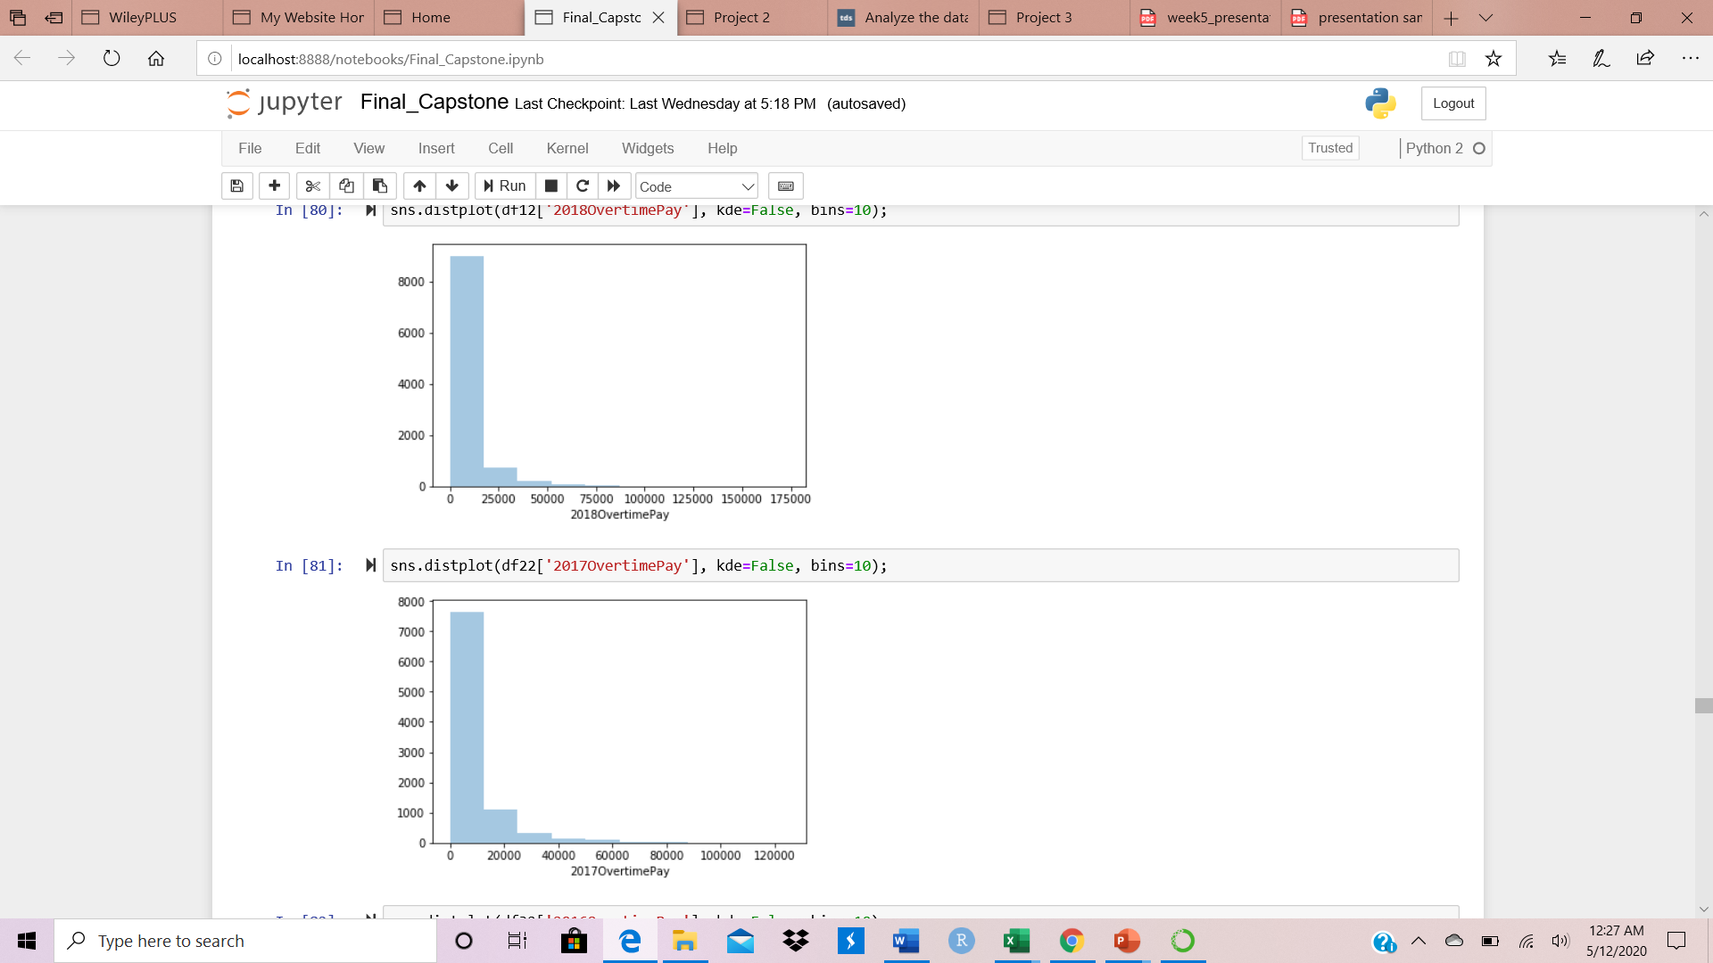
2018 DESCRIPTIVE STATISTICS
Variables | 2018 Annual Salary | 2018 Gross Pay Received | 2018 Overtime Pay
Count | 10,071 | 10,071 | 10,071
Mean | 78,121 | 79,886 | 6,084
Std | 30,807 | 38,027 | 11,694
Min | 11,147 | 0 | 0
25% | 54,960 | 55,702 | 0
50% | 74,460 | 77,614 | 600
75% | 96,986 | 101,810 | 7,627
Max | 303,091 | 317,531 | 174,009

Slide 4
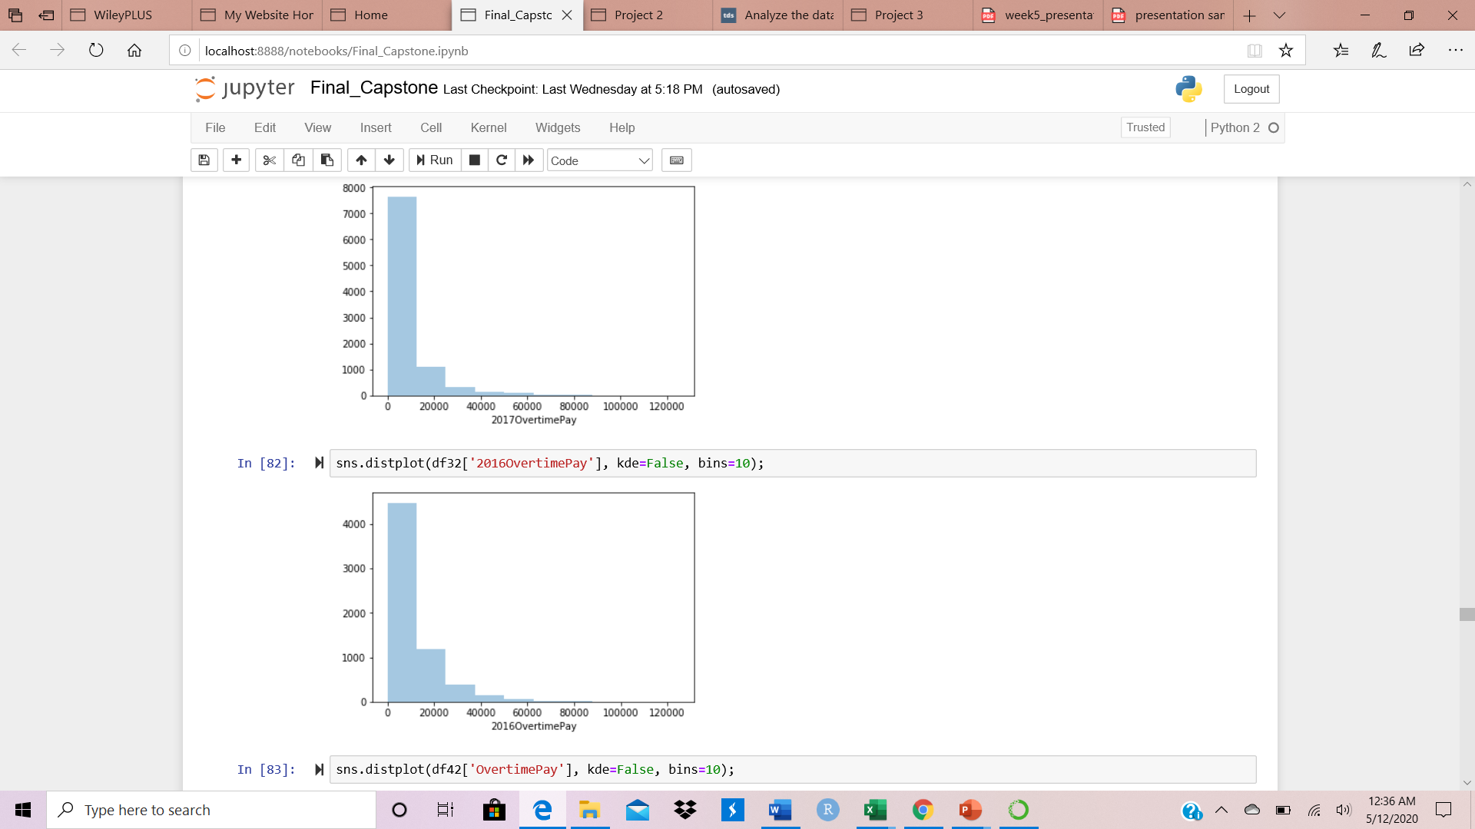
2017 DESCRIPTIVE STATISTICS
Variables | 2017 Annual Salary | 2017 Gross Pay Received | 2017 Overtime Pay
Count | 9,398 | 9,398 | 9,398
Mean | 75,571 | 79,651 | 7,002
Std | 29,875 | 36,965 | 12,249
Min | 11,147 | 0 | 0
25% | 53,747 | 55,562 | 0
50% | 71,495 | 76,972 | 1,592
75% | 95,084 | 101,211 | 9,189
Max | 303,091 | 315,216 | 125,275

Slide 5
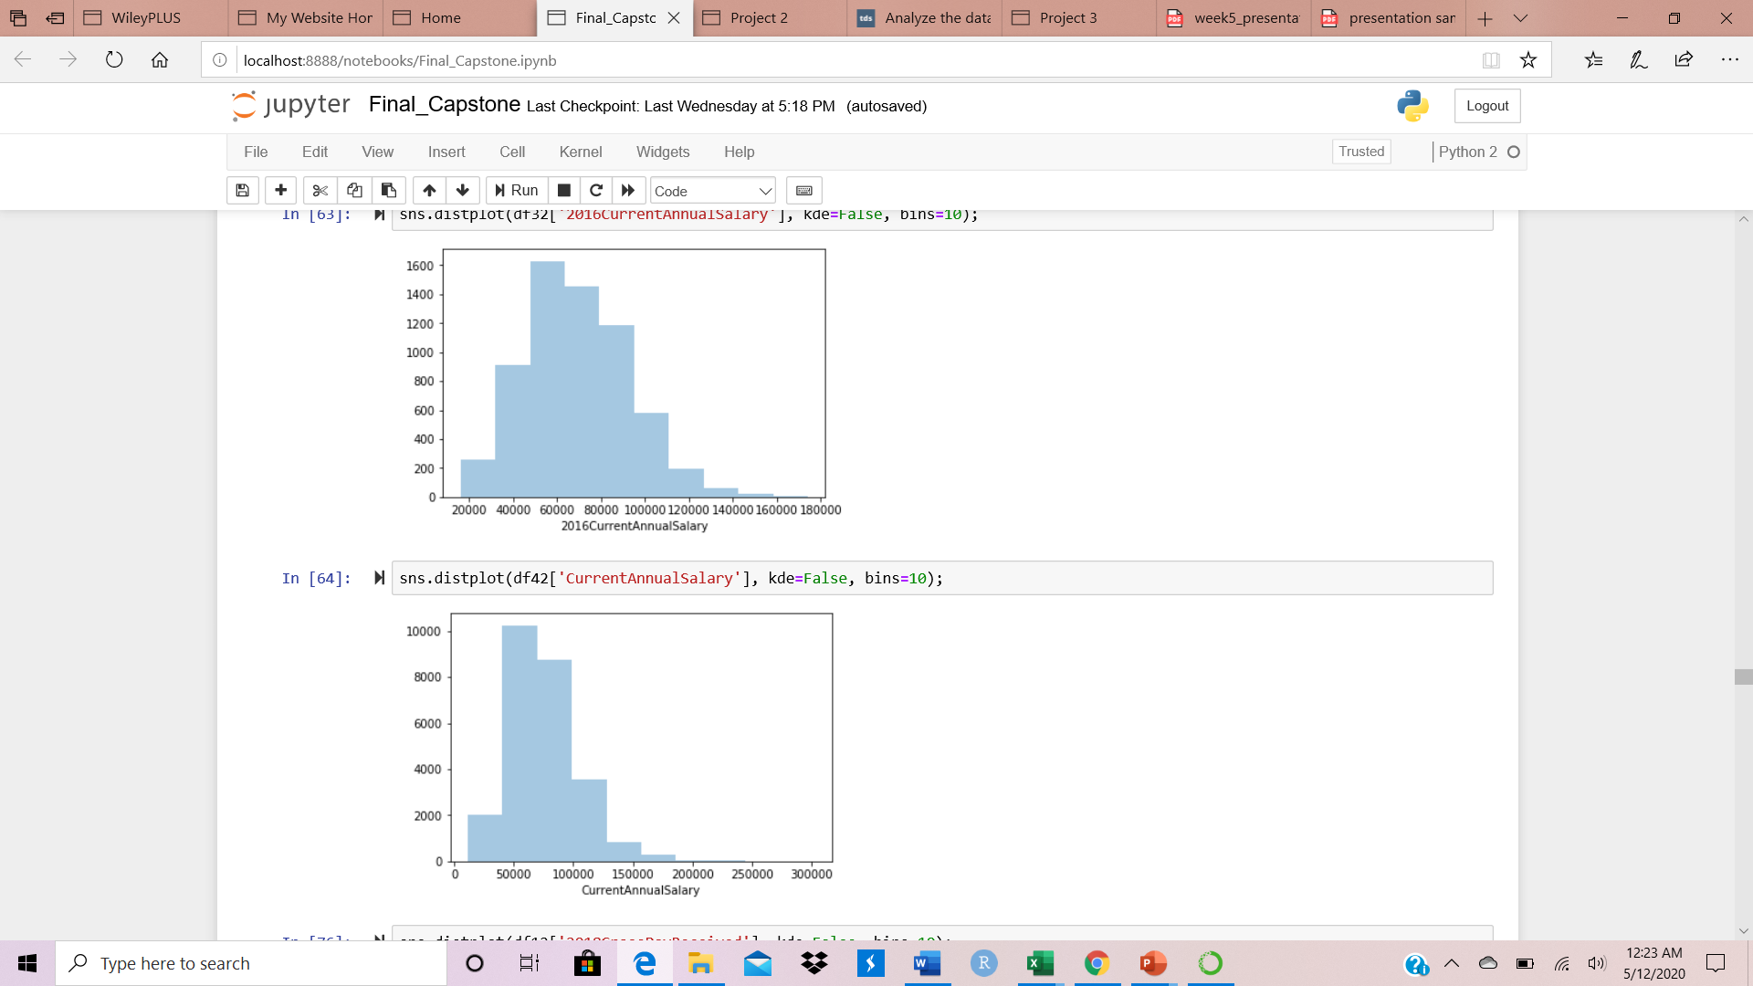
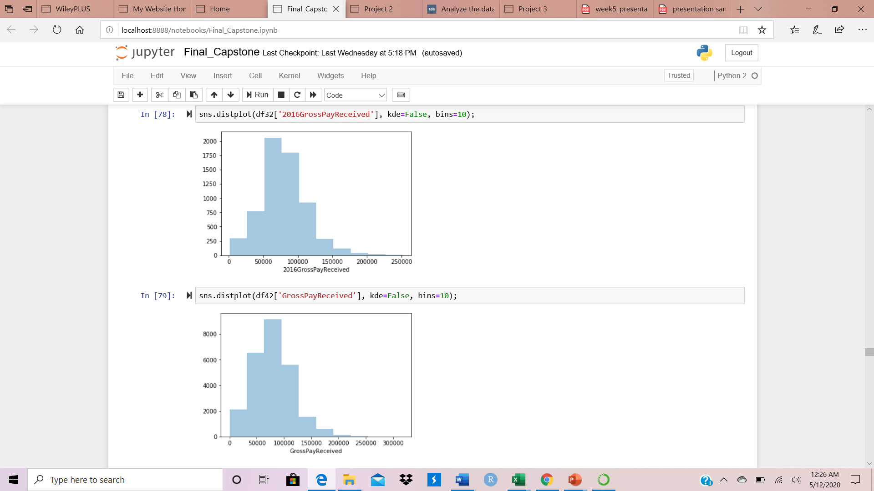
2016 DESCRIPTIVE STATISTICS
Variables | 2016 Annual Salary | 2016 Gross Pay Received | 2016 Overtime Pay
Count | 6,311 | 6,311 | 6,311
Mean | 69,265 | 79,520 | 10,335
Std | 23,943 | 32,743 | 12,678
Min | 15,969 | 1,408 | 0
25% | 51,697 | 57,887 | 1,728
50% | 66,065 | 76,858 | 6,184
75% | 86,588 | 98,523 | 14,310
Max | 174,166 | 251,850 | 125,244

Slide 6
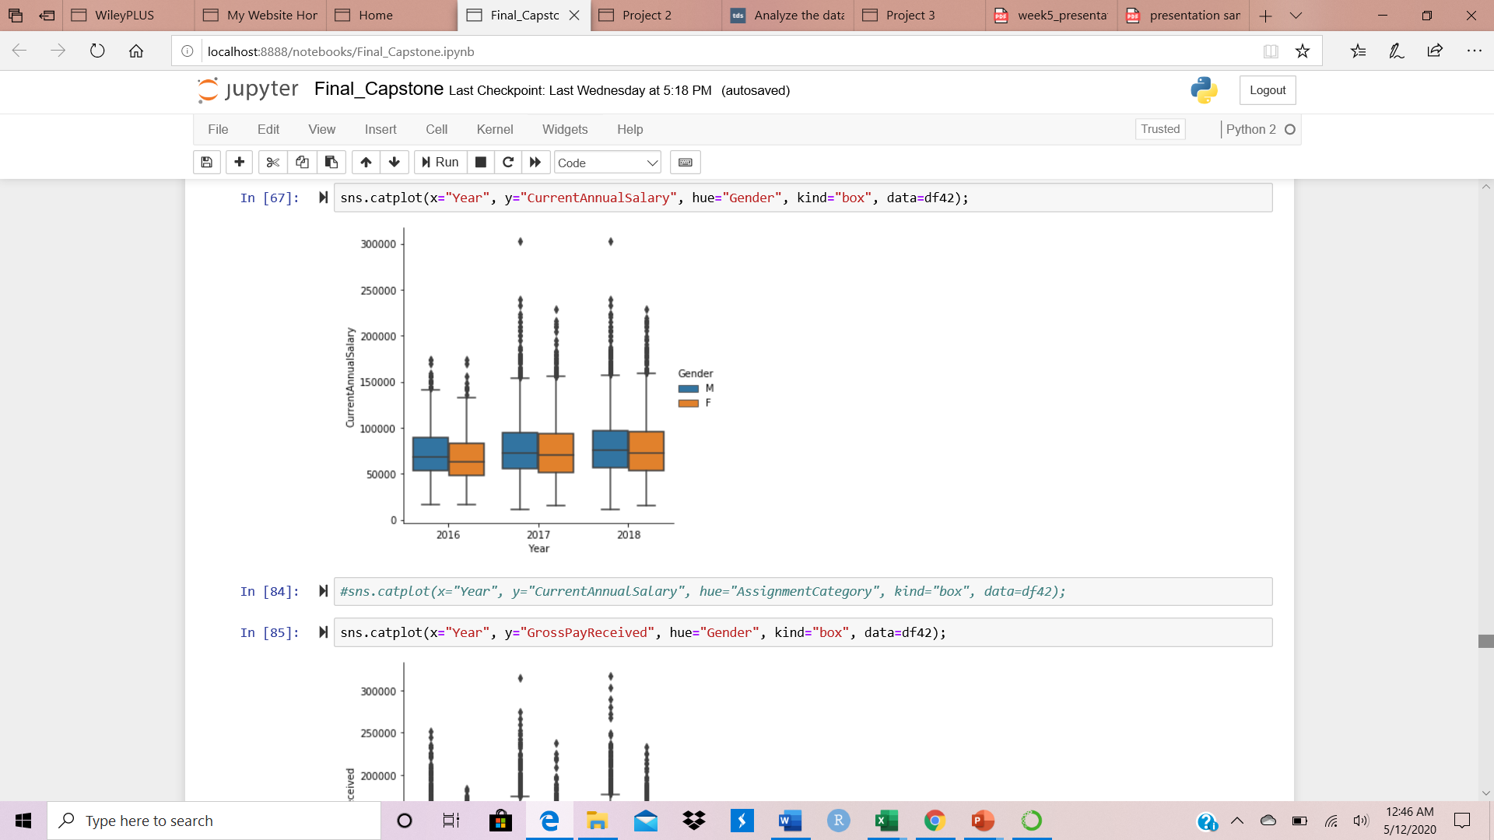
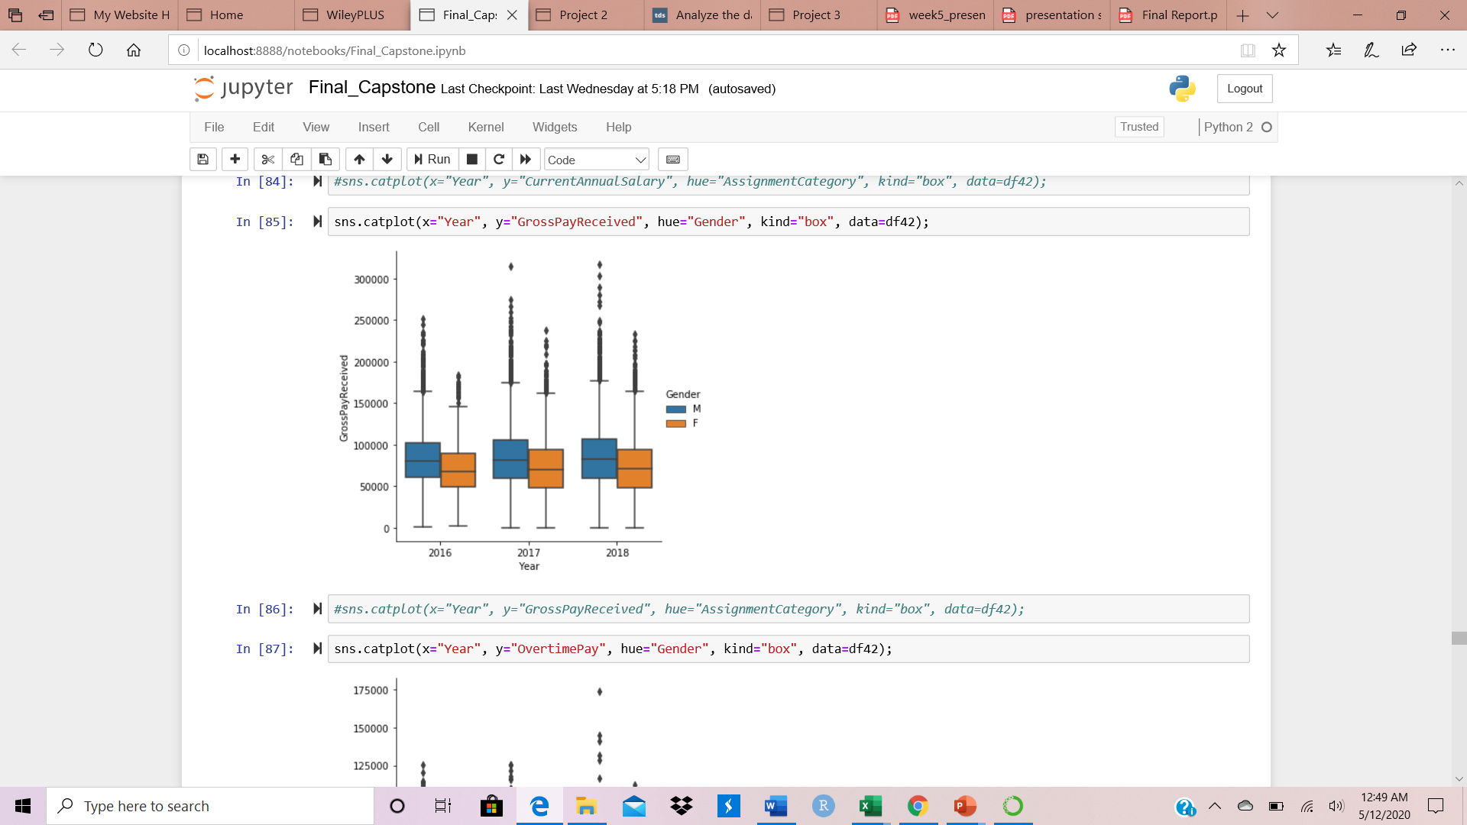
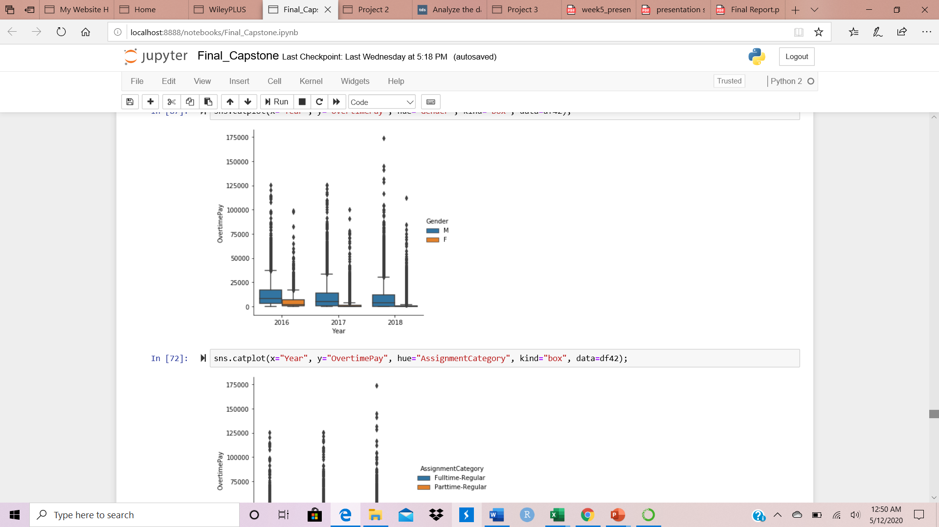
COMPARING SALARY VS GENDER OVERTIME
Gross Pay Received = Current Annual Salary + Overtime Pay

Slide 7
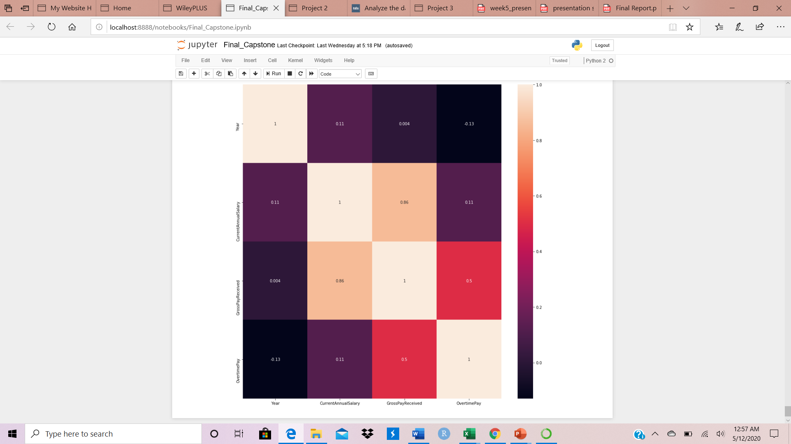
CORRELATION BETWEEN VARIABLES

Slide 8
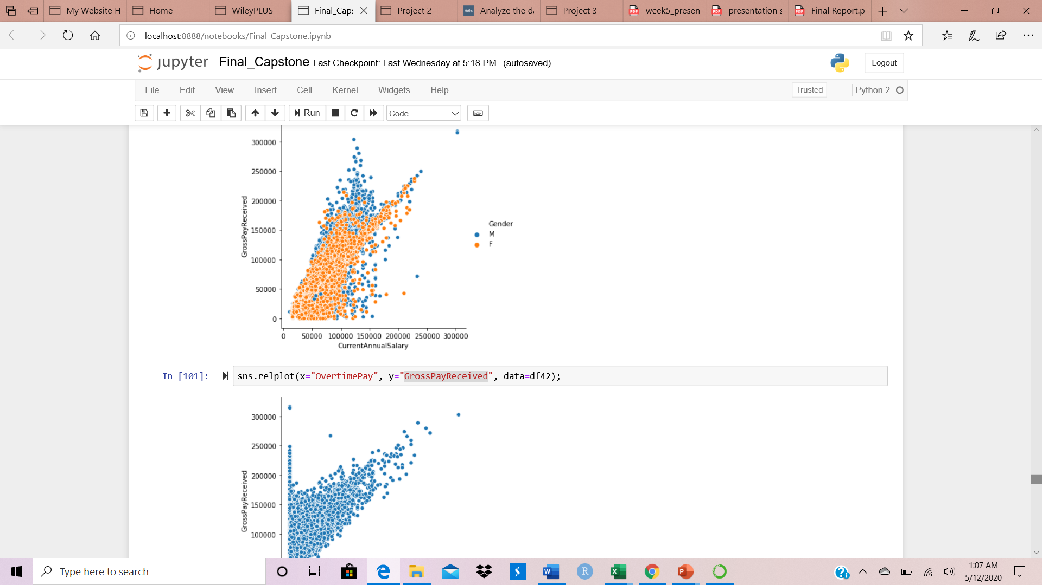
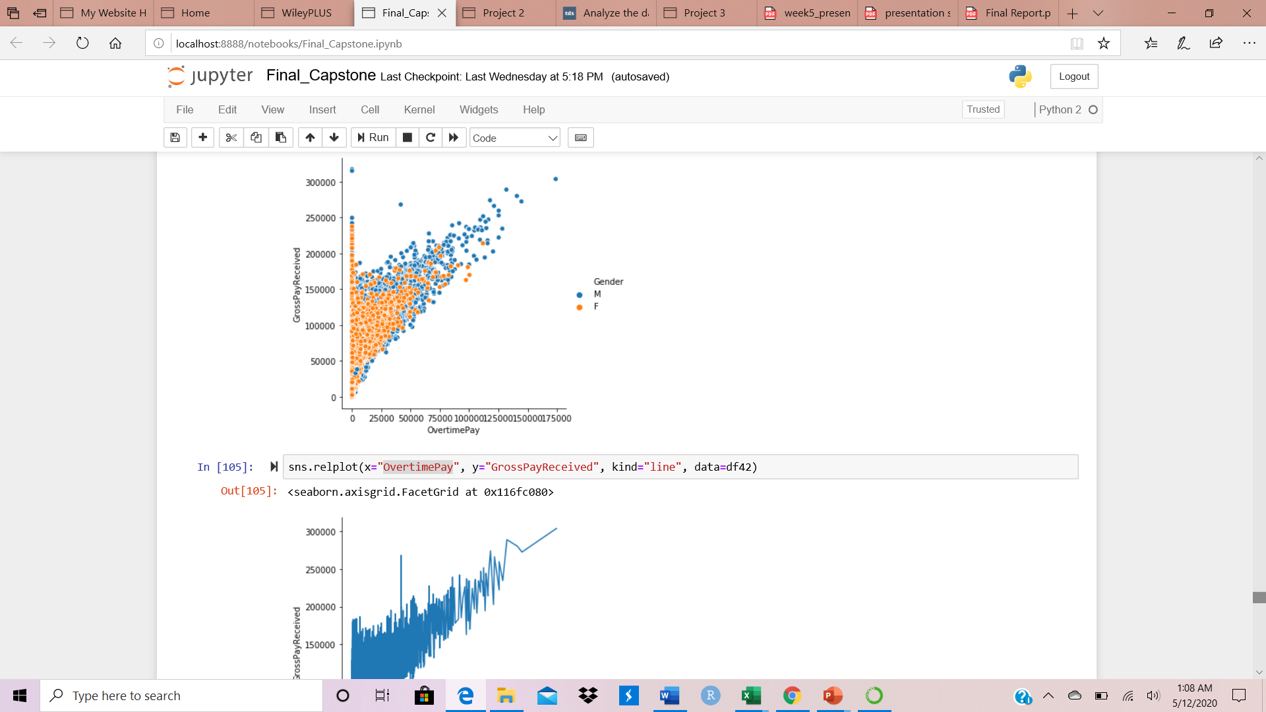
RELATIONSHIP BETWEEN SALARY COMPONENTS

Slide 9
SYNTHESIS OF FINDINGS
The distribution of salary is generally non symmetric with skewed to the right at all between 2016 and 2018.
While the medians are slightly different in the Current Annual Salary between 2016 and 2018, the distribution for males is more highly skewed to the right, so the mean for males will be higher than the mean for females.
The medians are quite a bit different in Gross Pay Received over time, the distribution for males is more highly skewed to the right, so the mean for males will be higher than the mean for females. The largest outliers in the dataset are mostly males.

Slide 10
SYNTHESIS OF FINDINGS
The Overtime Pay is mostly dominated by males between 2016 and 2018. As the components of Gross Pay Received are Current Annual Salary and Overtime Pay, the changing in Gross Pay Received is almost influenced by males. By looking at the dataset, police officers and fire and Rescue specialists are dominants in overtime at all. These positions are mostly filled by males. Thus, they have the highest Gross Pay Received every year.

Slide 11
RECOMMENDATIONS
Create a column as retained tax to explain the gap between gross salary, current salary, and overtime pay;
Update the column of overtime pay;
Create a column as education (Master, Bs, AA , Certificate, other….)

Slide 12
ACKNOWLEDGEMENTS
Thank you:
Professor Mohamed Abdirisak and Rachel Saidi for guiding our first steps in the use of data analysis tools, such as R, Python, and Tableau to describe data stories;
Professor Hamman, John for supporting us to achieve our final project;
Professor Kathryn Linehan for bringing the greatest professors to the Data Science Certificate Program;
Dennis Linders, Montgomery County Government, and Victoria Lewis, dataMontgomery for their support and direction.

